Slide 1
Improving Prosim Insurance's Claims Process Assignment
Advanced Decision Analysis EBADA5A
Post Graduate Diploma Industrial Engineering
In the Faculty of Industrial Engineering and Operations Management
By: Bonginkosi Emmanuel Ndaba
215327438

Slide 2
Abstract
Prosim Insurance, is a leader in the short-term insurance industry, has experienced a significant decline in market position due to inefficiencies in its claims process. Customers have expressed dissatisfaction with lengthy processing times, lack of communication, and errors in claims handling, resulting in a 10% annual customer attrition rate. To address these challenges, a Lean Six Sigma project is initiated to streamline the claims process, reduce processing time, and improve overall customer satisfaction. This study employs data-driven methodologies to analyze existing inefficiencies, identify root causes, and implement solutions aimed at optimizing workflow and minimizing delays. By leveraging process improvement techniques, this project aims to enhance service quality while balancing financial sustainability.

Slide 3
AGENDA
Define
Measure
Analyse
Improve
Control

Slide 4
AGENDA
Define
Map the Customer Journey
Translate VOC to CTQs
Project Charter

Slide 5
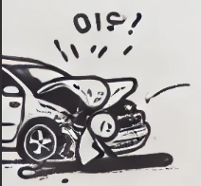











CUSTOMER JOURNEY MAP
On Stage
(what the customer experiences)
Event | Involved in Accident | Report Incident | Wait for Courtesy Vehicle | Searching for Service Providers | Send Documents | Follow-Up Call for Claim Status | Follow-Up with Manager | Paperwork Processed Notification | Receive Payment
Timeline | Day 0 | Day 0 | Day 0 | Day 1-2 | Day 3 | Day 10 | Day 17 | Day 22 | Day 52
Off Stage
(our internal interaction with the process)
The customer journey map reveals significant inefficiencies, including delays, repetitive steps, poor communication, and mismanaged processes. These issues result in frustration, stress, and a loss of trust from customers, highlighting the need for improvements in the claims process.

Slide 6
CUSTOMER MOMENT MAP
Step | STEP 1 | STEP 2 | STEP 3 | STEP 4 | STEP 5 | STEP 6 | STEP 7 | STEP 8 | STEP 9
Description of Step | Involved in Accident | Report Incident | Wait for Courtesy Vehicle | Searching for Service Providers | Send Documents | Follow-Up Call for Claim Status | Second Follow-Up | Notification of Paperwork Receipt | Receive Payment
Customer Expectation | Immediate support and assurance from insurance | Efficient, quick claim initiation process | Timely support and logistics services | Assistance in managing post-accident necessities | Seamless document handling and processing | Regular updates and clear communication | Issue resolution and managerial intervention | Confirmation of process continuation | Accurate and timely financial settlement
Moments of Pain | Stress from incident | Repeating information multiple times | Delay in courtesy vehicle arrival | Burden of sourcing service providers | Documents lost, needing resubmission | Lack of updates, having to follow up | Needing managerial intervention without resolution | Delay in processing notification | Incorrect amount, delayed payment
Moments of Magic | Initial relief from having insurance |  | Quick vehicle arrangement |  | Prompt acknowledgment of documents | Timely and informative feedback | Direct manager involvement | Confirmation of process progression | Payment Recieved
Customer Emotions Evoked | Initial relief, followed by stress | Frustration, annoyance | Anxiety, inconvenience | Stress, exhaustion | Annoyance, fear of mismanagement | Frustration, helplessness | Anger, need for action | Disappointment, diminished trust | Exhaustion, disappointment
Recommended Actions | Enhance initial contact procedures to ensure faster support | Streamline information collection, integrate data systems | Implement a real-time tracking and faster dispatch system | Provide a network of approved service providers to speed up the process | Improve document management systems, ensure digital submissions | Establish proactive communication protocols, automated status updates | Train staff for higher accountability, empower immediate resolutions | Enhance internal tracking and customer notification systems | Audit and revise payment procedures to ensure accuracy and timeline
The customer moments map highlights key issues in the claims process, including repetitive information requests, delays in communication, lost documents, and an incorrect payment. These inefficiencies cause frustration, stress, and disappointment for customers, demonstrating the need for better management of touchpoints to enhance their overall experience.

Slide 7
VOC TO CTQ
 | Voice of the Customer | VOC | Priority Rank | Critical to Quality (CTQ)
1 | “How long is this going to take?” | Speed of processing claims | 1 | Average claims lead time ≤ 6 days
2 | “I want the same speedy response that Prosim gets when I receive my bill.” | Timely and consistent communication | 2 | Real-time updates throughout the claims process
3 | “I expect the correct payout with no sneaky surprises or hidden clauses.” | Accuracy and transparency in claims | 1 | Claims accuracy ≥ 80%
4 | “Friendly and professional call center agents!” | Professionalism and quality of interaction | 3 | Customer service quality ≥ 90% satisfaction
5 | “Give me my money now!” | Faster claim resolution | 2 | Timely payouts within 6 days
6 | “I hate doing refunds because the service provider had a glitch.” | Error-free claims processing | 3 | Reduce rework by 50%
7 | “What is my cover?” | Clarity and transparency in policy details | 4 | 100% policy clarity for customers
8 | “Preserve interest income.” | Maintain financial sustainability | 4 | Average cost per claim ≤ $5
The VOC to CTQ Table clearly converts customer feedback into measurable quality goals. Each VOC, like "How long is this going to take?" or "Preserve interest income," is prioritized and linked to specific CTQs. The inclusion of "Cost per Claim" under financial sustainability ensures both customer and operational needs are addressed.

Slide 8
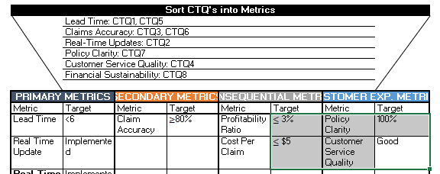
VOC TO CTQ
The Sorted CTQs into Metrics section organizes CTQs effectively:
Primary Metrics: Focus on key customer outcomes like lead time.
Secondary Metrics: Address process improvements such as Accuracy.
Consequential Metrics: Ensure financial and operational stability.
Customer Experience Metrics: Focus on service quality and satisfaction.
This grouping makes it easy to track progress and impact.

Slide 9
PROJECT CHARTER
Business Case
The current claim processing system results in significant delays, inconsistent communication, and high customer dissatisfaction. Streamlining the process is important now to improve customer experience, reduce operational costs, and maintain competitiveness. Addressing these inefficiencies immediately will help maintain customer loyalty, prevent further losses, and ensure we remain competitive in the industry. This project aligns with the overall business strategy of enhancing customer service quality, operational efficiency, and reducing costs through effective process management.
Problem Statement
The existing claims process is slow, lacks transparency, and leads to customer dissatisfaction. Customers frequently experience long waiting times and inconsistent communication, leading to a decline in overall customer retention and a negative impact on brand reputation. The problem is observed across the Claims Department and Customer Service teams, and it has been ongoing for the past 12 months, affecting around 60% of claims. The current lead time is 12 days, which needs to be reduced.

Slide 10
PROJECT CHARTER
Add the most important aspects from your Project Charter. Can do this over more than one page for clear readability.
May complete this tool in your Excel Toolkit and copy & paste on this slide.
Goal Statement
Reduce average claims lead time to 6 days, improve claims accuracy to 80%, and provide real-time updates to customers throughout the claims process while maintaining the financial feasibility of processing claims. This will lead to improved customer satisfaction and streamlined internal operations.
Project Scope
This project will cover the entire claim processing workflow, including data collection, communication with customers, and final payout. The project will exclude legal processes and policy underwriting activities.

Slide 11
PROJECT CHARTER
Expected Benefits Hard Benefits
Description | Baseline Amount | Actual Amount | Comments / Reasons
Cost Reduction | $500,000 annually | $300,000 annually | Reduction in waste costs related to claim errors
Increased Revenue | $800,000 annually | $1,000,000 annually | Improved processing speed leads to more processed claims per year
The cost reduction specifically addresses unnecessary administrative costs and rework in the claims process, while increased revenue is tied to improved efficiency in processing claims.
Soft Benefits
Description | Baseline Amount | Actual Amount | Comments / Reasons
Customer Satisfaction | Current rating | +15% | Improved communication and faster service
Cost Avoidance | N/A | Avoided costs | Preventing costs related to manual errors and rework
Employee Retention | Moderate | Improved | Simplified processes reduce stress and improve retention

Slide 12
PROJECT CHARTER
Add the most important aspects from your Project Charter. Can do this over more than one page for clear readability.
May complete this tool in your Excel Toolkit and copy & paste on this slide.
Project Resources
Proposed Team |  | Other Resources
Name | Role | Name | Role
John Smith | Team Member: Client Support Service | IT Support Team | Technical Assistance
Jane Doe | Process Owner: Claims Specialist | Legal Advisor | Compliance Guidance
Mark Johnson | Team Member: Customer Service Lead | Call Center Agents | Provide Process Insights
Susan Clark | Financial SME: Financial Analyst
Bonginkosi Ndaba | Green Belt: Process Improvement Lead
Peter Adams | Champion: Project Sponsor

Slide 13
DEFINE PROJECT REVIEW CHECKLIST
Use this Checklist to determine if you have completed all the relevant deliverables for the Define Phase in order to schedule your tollgate review session.
Choose either Yes or No to show the status of the deliverable. .
Complete Defining the Problem | Complete
Customer Experience evaluated? | Yes / No
CTQ’s Identified? | Yes / No
Stakeholders Identified? | Yes / No
Communication Plan Completed? | Yes / No
Project Charter Developed? | Yes / No
Business Case Created? | Yes / No
Problem Statement Developed? | Yes / No
Goal Statement Completed? | Yes / No
Project Scope Identified? | Yes / No
Benefits Estimated? | Yes / No
Project Resources Assigned? | Yes / No

Slide 14
AGENDA
Define
Measure
Analyse
Improve
Control

Slide 15
AGENDA
Measure
Process Map
Process Capability
Identify & Screen Inputs
Data Collection

Slide 16
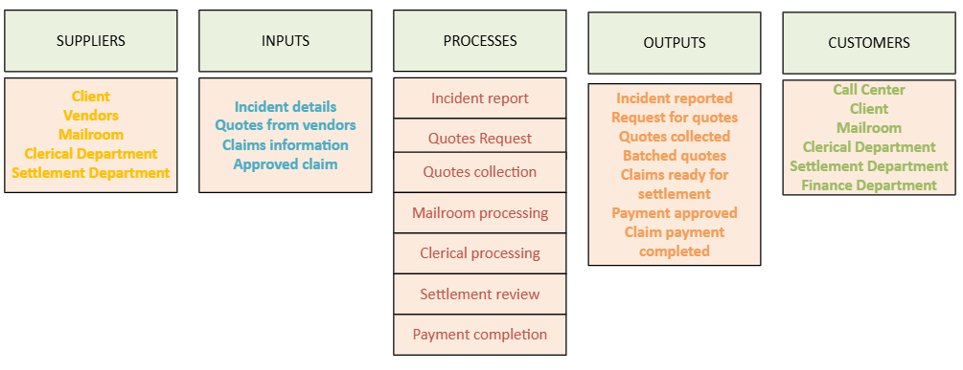
AS IS PROCESS MAP-SIPOC
The SIPOC diagram provides a high-level view of the claims process, allowing us to understand how inputs are transformed into outputs across each major process stage. It highlights the relationships between suppliers, the internal processes, and the final outputs delivered to customers. This consolidated overview supports the identification of value-added steps and potential inefficiencies in the claims handling process.

Slide 17
AS IS PROCESS MAP-DETAILED
Client
Report Incident
Get Vendor
Quotes
Start
Incident Details
Quotes
Receive Incident
Request Vendor
Quotes
Call Centre
Incident Report
Yes
Receive and
Date Stamp
Quotes
Any Missing
Document?
Storage
No
Mail Room
Stamped
Quotes
Batch of
Quotes
Load Claims
Data Into
System
Research
Claims
Store
Claims
Release Claims
Clerical Département
Batch of
Claims
Settlement Department
Request Claim
Release
on System
Approve?
Research
Claims
Make Payment
Yes
End

Slide 18
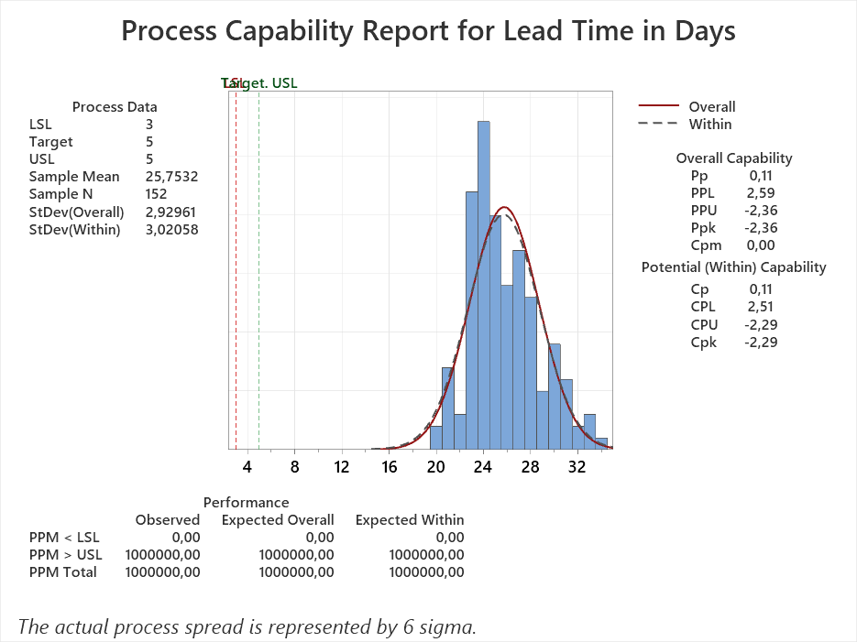
PROCESS CAPABILITY: PRIMARY METRIC
Unit | The item produced or processed – either a product or service transaction | Claims Process at Prosim Insurance | N = 152
Defect | Any event that does not meet the specification of a CTQ. | Claims that does not meet the specification of lead time (target of 5 days +- 1 day) | D = 152
Defect Opportunity | Any event which can be measured that provides a chance of not meeting a customer requirement | Each claim has one opportunity to meet the target lead time. | O = 1
Insights from the Capability Report
Process Mean: The average lead time is 25.75 days, far above the target of 5 days.
Standard Deviation: The standard deviation is 2.93 days, indicating high variability.
Capability Metrics: Metrics like PPU/Ppk (-2.25) and CPU/Cpk (-2.18) reflect poor performance and inability to meet targets.
Observations
The process lead time is significantly higher than the target of 5 days.
High variability indicates a lack of consistency in processing claims processing.
Next Steps
Investigate causes of delays and variability in the process leading to mean of 25.75 days
Note: The capability analysis was conducted using Minitab.

Slide 19
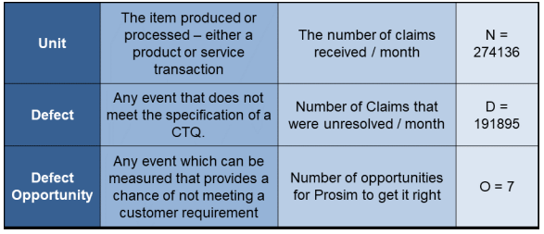



PROCESS CAPABILITY: SECONDARY METRIC
N=274136 D=191895 O=7
The calculated DPMO (Defects Per Million Opportunities) of 100,000 indicates a significant level of defects within the process, resulting in a sigma level of 1.5. This highlights a need for efforts on accuracy improvement, as the current defect rate suggests there are many opportunities where customer requirements are not being met effectively. Addressing these defect opportunities will help in increasing process capability.
$DPMO=\frac{D}{N X O}$ X 1000000
$DPMO=\frac{191895}{274136 X 7}$ X 1000000
$$DPMO=100000$$
Sigma Level= 1.5

Slide 20

IDENTIFY INPUTS - BRAINSTORMING
Give each team member a pen so it is not just the facilitator who can filter ideas by writing down what he/she likes!
Respect the process.
Ensure all participants understand the rules of brainstorming.
You may choose to group ideas in an Affinity Diagram. You can also add slides if you chose to do this.
Insurance
Type
Manual
Handling
Errors
Research and
Release Time
Vendor
Response
Times
Location
Batch
Processing
Staffing
Shortages
Technology
Issues
Document
Verification
Issues

Slide 21
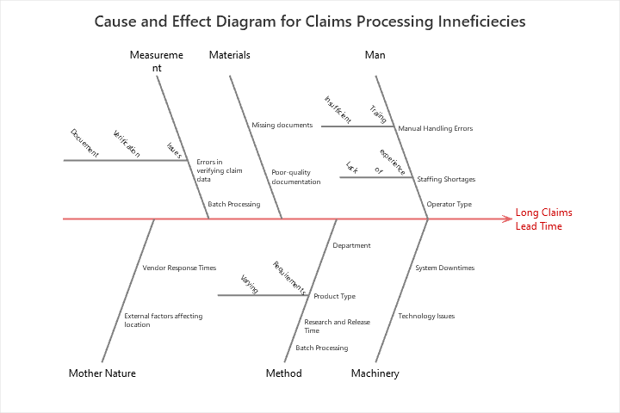
IDENTIFY INPUTS – CAUSE & EFFECT DIAGRAM
The Fishbone Diagram has a number of categories to consider and might stimulate ideas about inputs missed by the other two techniques.
The Cause and Effect Diagram provides a visual representation of the primary factors contributing to long claims lead time. By categorizing root causes into key areas such as Man, Machinery, Method, and Materials, it helps us pinpoint areas of inefficiency, including the impact of batch processing, system downtimes, and operator variations. This structured approach will guide us in addressing the most critical drivers of delays

Slide 22
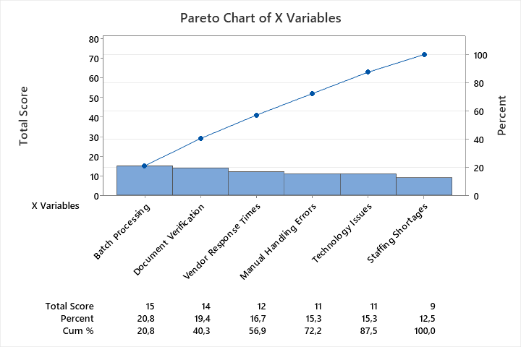
SCREENING INPUTS – XY MATRIX
X Variables | CTQ 1: Lead Time | CTQ 2: Accuracy | Total Score | Rank
Batch Processing | 8 | 7 | 15 | 1
Vendor Response Times | 8 | 4 | 12 | 3
Manual Handling Errors | 5 | 6 | 11 | 4
Technology Issues | 6 | 5 | 11 | 4
Staffing Shortages | 4 | 5 | 9 | 5
Document Verification | 6 | 8 | 14 | 2
XY Prioritization Matrix and Pareto Chart identified key contributors to claims processing issues.
Batch Processing, Document Verification, Vendor Response Times, and Manual Handling Errors are the top four contributors.
These top four factors account for over 72% of the overall issues.
Addressing these factors will significantly improve lead times and accuracy.

Slide 23
DATA COLLECTION PLAN
Measure | Type of Measure | Type of Data | Operational Definition | Sampling Frequency | Who by When
Batch Processing Time | Input | Continuous | Time taken from batch initiation to completion | Daily, Sample 20 claims each week | Process Owner - Next Month
Document Verification Errors | Output | Discrete | Number of errors in verified documents | Weekly, Sample 15 verified documents | QA Team - End of Month
Vendor Response Time | Input | Continuous | Time taken for vendors to respond to requests | Daily, Sample every vendor response | Procurement - Next Month
Manual Handling Errors | Output | Discrete | Number of manual errors in claims handling | Weekly, Sample 25 claims | Claims Team - End of Month

Slide 24
MEASURE PROJECT REVIEW CHECKLIST
Measure the Problem | Complete
Sigma Level Identified? | Yes / No
Measurement System Analysed? | Yes / No
Process Map Developed? | Yes / No
Inputs Identified | Yes / No
Inputs Screened for most likely causes? | Yes / No
Data Types Identified? | Yes / No
Data Collection Plan Completed? | Yes / No

Slide 25
AGENDA
Define
Measure
Analyse
Improve
Control

Slide 26
AGENDA
Analyse
Analyse Phase Plan
Display Data Graphically
Analyse Data Statistically
Process Analysis for Value

Slide 27


PLAN FOR ANALYSE
Likely Cause | Type of Input | Graphical Technique | Statistical Technique | Process Technique | Confirmed Root Causes
Location | Discrete | Boxplot | ANOVA | Hypothesis Testing
Average Cost to Serve | Continuous | Scatterplot | Regression Analysis | Regression Analysis
Department | Discrete | Boxplot | ANOVA | Hypothesis Testing
Insurance Type | Discrete | Boxplot | 2-Sample T Test | Hypothesis Testing

Slide 28
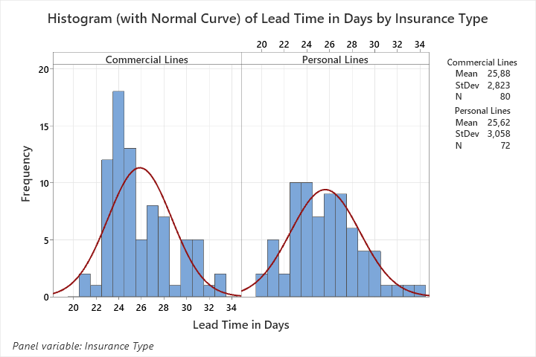
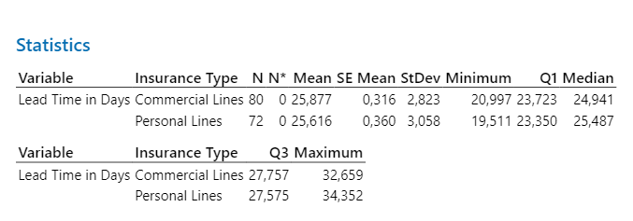
ROOT CAUSE 1 - DISPLAY DATA

Slide 29
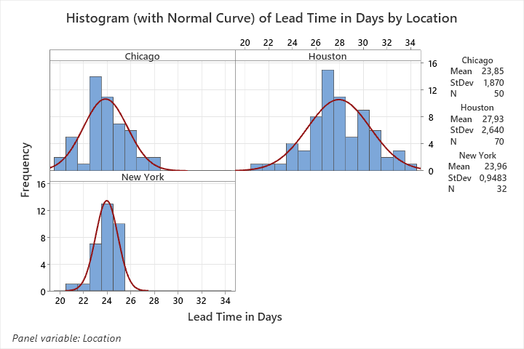
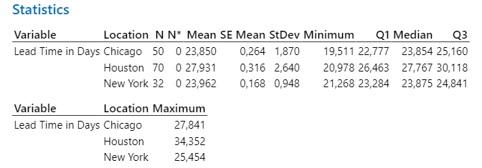
ROOT CAUSE 2 - DISPLAY DATA

Slide 30
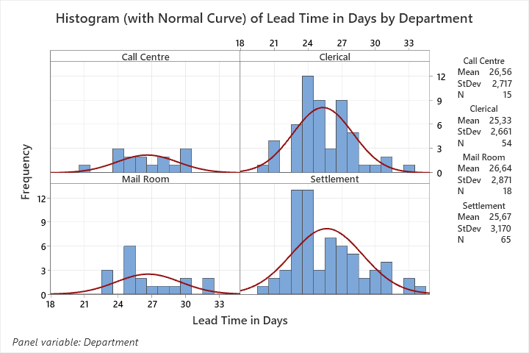
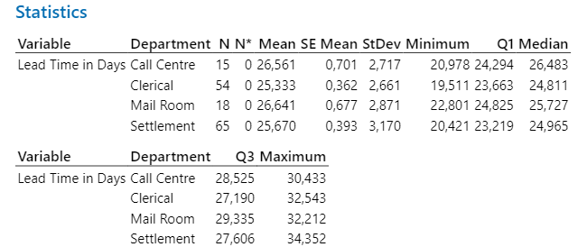
ROOT CAUSE 3 - DISPLAY DATA

Slide 31
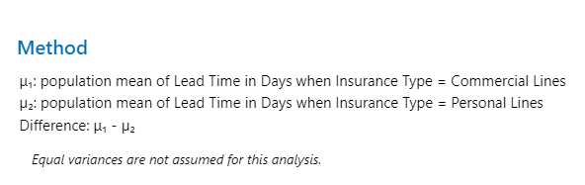
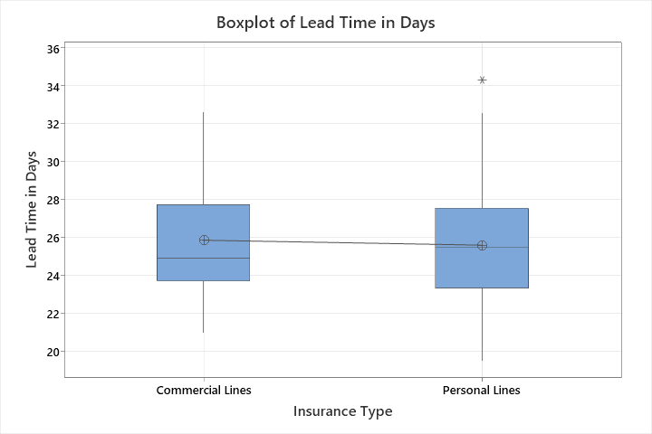
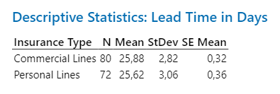
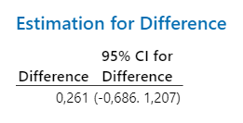
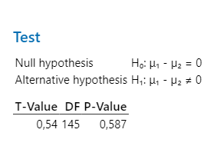
ROOT CAUSE 1 - STATISTICAL ANALYSIS
ROOT CAUSE VALIDATION: INSURANCE TYPE
P-value = 0.578
Conclusion: Which a P-value greater than 0.05 at 95% confidence level, we cannot validate Insurance Type as root cause there is no statistical evidence that insurance type significantly impacts lead time

Slide 32
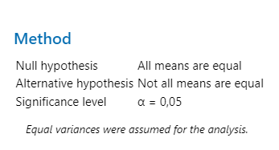
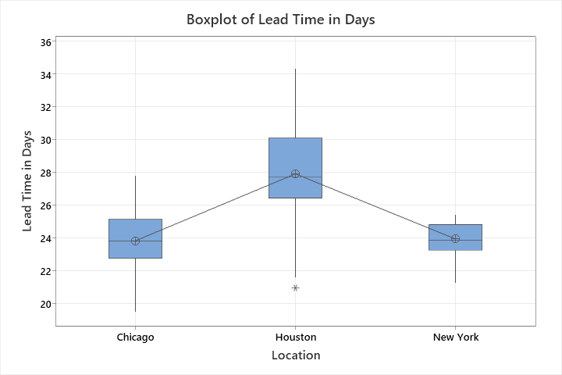
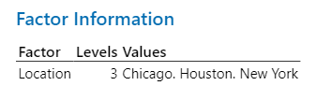
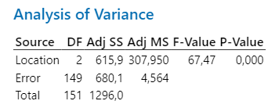
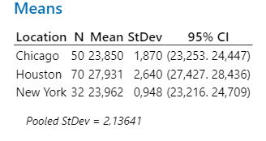
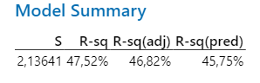
ROOT CAUSE 2 - STATISTICAL ANALYSIS
ROOT CAUSE VALIDATION: LOCATION
Conclusion:
P-value = 0.000
Conclusion: Which a P-value Less than 0.05 at 95% confidence level, we can validate Location as a root cause because there is statistical evidence that Location significantly impacts lead time. With Houston Exhibiting more Lead Time Compared Chicago and New York.

Slide 33
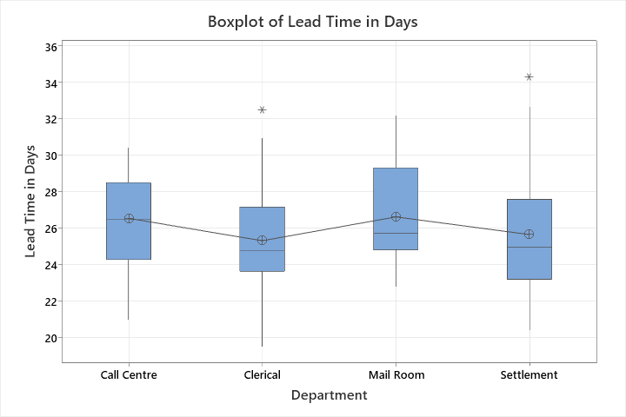
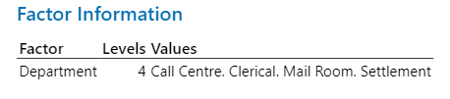
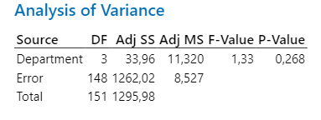
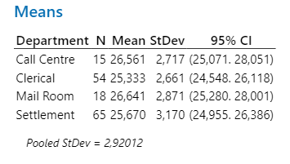
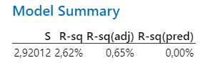
ROOT CAUSE 3 - STATISTICAL ANALYSIS
ROOT CAUSE VALIDATION: DEPARTMENT
Conclusion:
P-value = 0.268
Conclusion: Which a P-value greater than 0.05 at 95% confidence level, we cannot validate Department type as root cause there is no statistical evidence that department type significantly impacts lead time

Slide 34
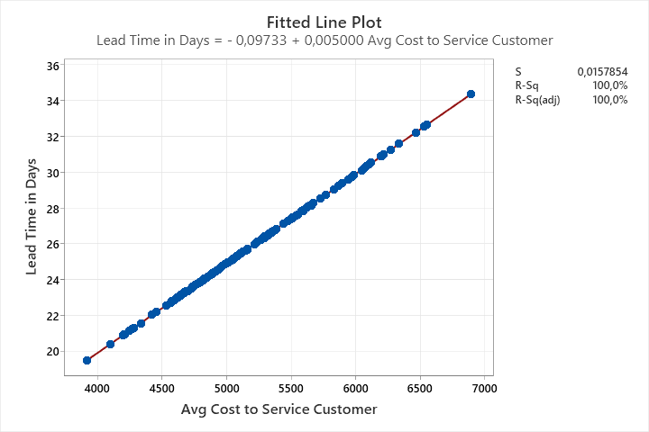
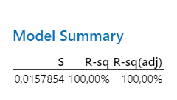
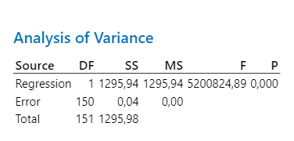
ROOT CAUSE 4 - STATISTICAL ANALYSIS
ROOT CAUSE VALIDATION: AVG COST TO SERVICE CUSTOMER
P-value = 0,0000
The regression analysis shows a p-value of 0.000, indicating a significant correlation.
Conclusion: Although there is a significant correlation between average cost and lead time, correlation does not imply causation. It is possible that increased lead times are driving higher costs rather than cost being a root cause. Further investigation is needed to confirm causation.

Slide 35
FURTHER STATISTICAL ANALYSIS: ACCURACY
Beyond determining the root causes of lead time issues, I also proceeded to determine the root causes for poor accuracy performance. The validated root causes are Operator, Product Type, and Lead Time, each significantly impacting the accuracy of claims processing. The First Time Resolution factor, however, did not show significant statistical evidence as a root cause for accuracy issues.
Likely Cause | Type of Input | Graphical Technique | Statistical Technique | Process Technique | Confirmed Root Causes
Operator | Discrete | Boxplot | ANOVA | 5 Whys
Product Type | Categorical | Boxplot | ANOVA | Process Mapping
First Time Resolution | Categorical | Boxplot | T-test | -
Lead Time | Continuous | Scatter Plot | Quadratic Regression | Process Re-design

Slide 36
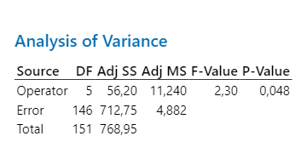
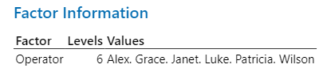
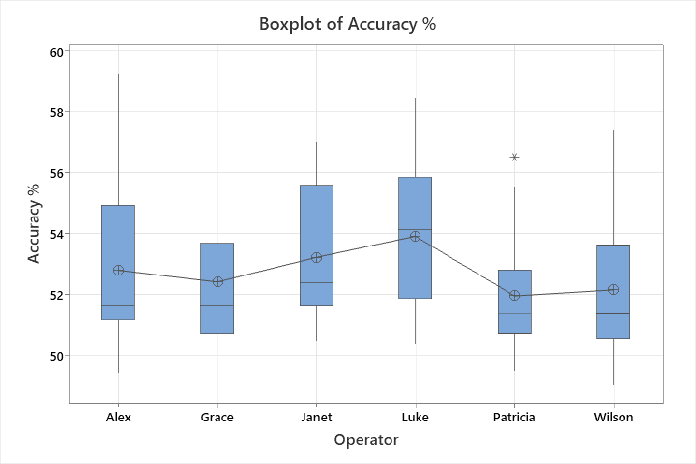
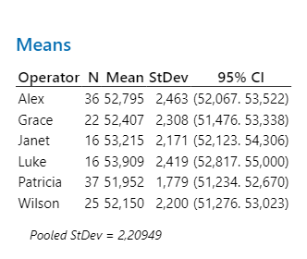
ROOT CAUSE 1-ACCURACY- STATISTICAL ANALYSIS
ROOT CAUSE VALIDATION: OPERATOR
Conclusion: Which a P-value less than 0.048 at 95% confidence level, we can validate type Operator as root cause for poor accuracy because there is statistical evidence that Operator significantly impacts Accuracy.
P-value = 0.048

Slide 37
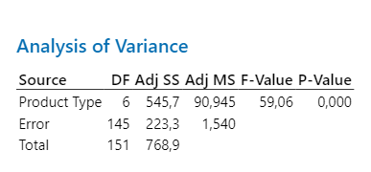
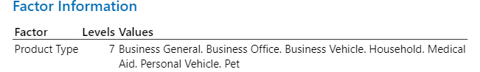
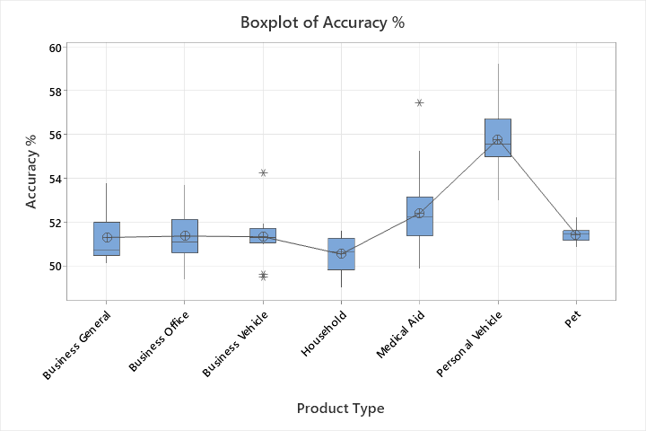
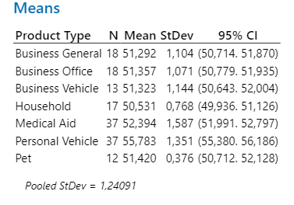
ROOT CAUSE 2-ACCURACY- STATISTICAL ANALYSIS
ROOT CAUSE VALIDATION: PRODUCT TYPE
Conclusion: Which a P-value less than 0.000 at 95% confidence level, we can validate type product type as root cause for poor accuracy because there is statistical evidence that productive type significantly impacts Accuracy.

Slide 38
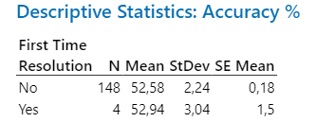
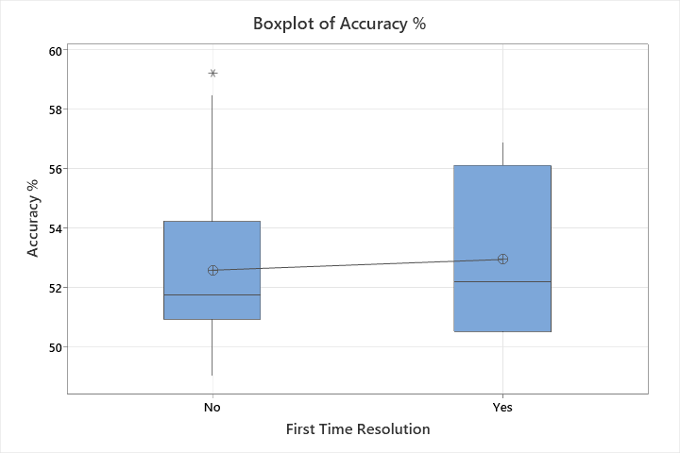
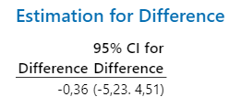
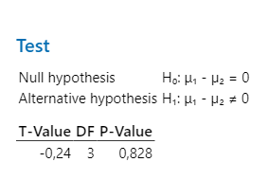
ROOT CAUSE 3-ACCURACY- STATISTICAL ANALYSIS
ROOT CAUSE VALIDATION: FIRST TIME RESOLUTION
Conclusion: Which a P-value less than 0.828 at 95% confidence level, we can validate first time resolution as root cause for poor accuracy because there is no statistical evidence that first time resolution significantly impacts Accuracy.

Slide 39
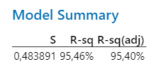
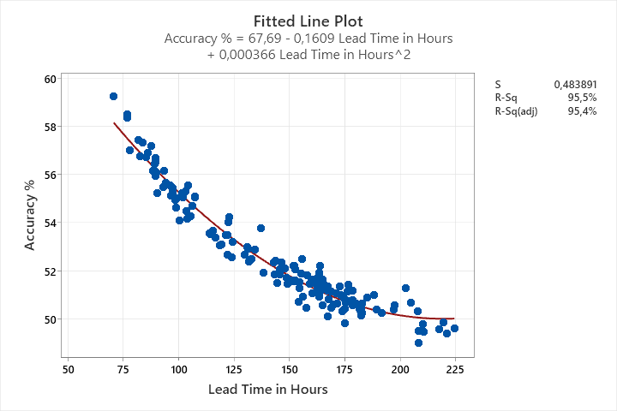
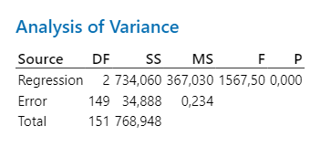
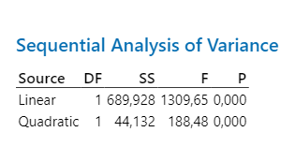
ROOT CAUSE 4-ACCURACY- STATISTICAL ANALYSIS
ROOT CAUSE VALIDATION: LEAD TIME
Conclusion: Which a P-value less than 0.000 at 95% confidence level, we can validate an increase in lead time results in a decrease in accuracy with an R-sq value of 95.46% Quadratic regression.

Slide 40
ANALYSE PROJECT REVIEW CHECKLIST
Type of Waste | Process Waste Identified
Transport | Rework on info from client Transporting documents to different areas for approval and verification.
Inventory | Client having to source 3 quotes Large. Batches of claims accumulating before processing in Settlement.
Motion | Re-capturing info from client document. Physical movement required to locate documents within departments.
Waiting | Researching by Clerk and Claims Supervisor Waiting for Settlement Department to call for a batch of claims.
Overproduction | Requesting more than three vendor quotes for a claim. Repeated requests for information from clients.
Over Processing | Multiple rounds of rework due to inconsistent information or lack of guidelines. Repeated document verification steps involving multiple stakeholders.
Defects | Keeping and releasing documents causing delays. Errors in indexing or entering data into the system.
Skills | Another review by supervisor. Lack of training or unclear instructions for document handling.

Slide 41
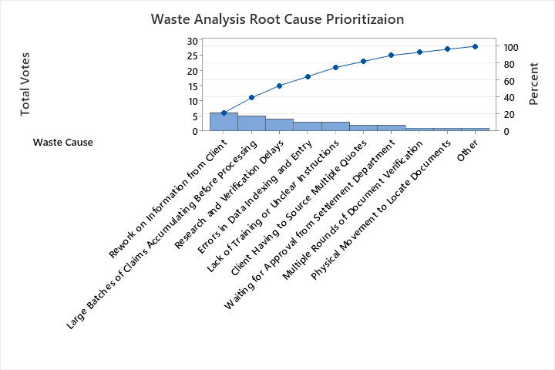
WASTE ANALYIS: CONTINUED
A multi-voting exercise was conducted with stakeholders to prioritize the most critical waste causes in the claims process, focusing efforts on addressing the highest impact issues effectively.
Waste Cause | John Smith | Jane Doe | Mark Johnson | Susan Clark | Bongienkosi Ndaba | Peter Adams | Total Votes
Rework on Information from Client | ✔ | ✔ | ✔ | ✔ | ✔ | ✔ | 6
Client Having to Source Multiple Quotes | ✔ |  | ✔ |  |  |  | 2
Transporting Documents for Approval and Verification |  |  |  | ✔ |  |  | 1
Large Batches of Claims Accumulating Before Processing | ✔ |  | ✔ | ✔ | ✔ | ✔ | 5
Physical Movement to Locate Documents |  |  | ✔ |  |  |  | 1
Research and Verification Delays |  | ✔ |  | ✔ | ✔ | ✔ | 4
Waiting for Approval from Settlement Department | ✔ |  |  |  |  | ✔ | 2
Repeated Requests for Information from Clients |  |  |  |  |  |  | 0
Multiple Rounds of Document Verification |  | ✔ |  |  |  |  | 1
Errors in Data Indexing and Entry |  |  | ✔ | ✔ |  | ✔ | 3
Lack of Training or Unclear Instructions |  |  |  | ✔ |  | ✔ | 3
The Pareto analysis highlights the top five contributors to waste in the claims process: "Rework on Information from Client," "Large Batches of Claims Accumulating Before Processing," "Research and Verification Delays," "Errors in Data Indexing and Entry," and "Lack of Training or Unclear Instructions." Together, these factors account for approximately 72.2% of the total waste. Addressing these issues will yield the most significant improvements in process efficiency.

Slide 42
PROCESS ANALYSIS SUMMARY
Likely Cause | Type of Input | Graphical Technique | Statistical Technique | Process Technique | Confirmed Root Causes
Rework on Information from Client | Discrete | Pareto Chart | Brainstorming (Multivolting) | Process Mapping
Large Batches of Claims Accumulating Before Processing | Continuous | Pareto Chart | Brainstorming (Multivolting) | Lean Process Improvement | ✅
Research and Verification Delays | Continuous | Pareto Chart | Brainstorming (Multivolting) | Value Stream Mapping | ✅
Errors in Data Indexing and Entry | Discrete | Pareto Chart | Brainstorming (Multivolting) | Error Proofing | ✅
Lack of Training or Unclear Instructions | Discrete | Pareto Chart | Brainstorming (Multivolting) | Training & Development | ✅
Client Having to Source Multiple Quotes | Discrete | Pareto Chart | Brainstorming (Multivolting) | Process Improvement | ❌
Waiting for Approval from Settlement Department | Continuous | Pareto Chart | Brainstorming (Multivolting) | Lean Process Improvement | ❌
Multiple Rounds of Document Verification | Discrete | Pareto Chart | Brainstorming (Multivolting) | Process Standardization | ❌
Physical Movement to Locate Documents | Continuous | Pareto Chart | Brainstorming (Multivolting) | Workplace Organization (5S) | ❌

Slide 43
ANALYSE PROJECT REVIEW CHECKLIST
Complete Analysing the Root Causes | Complete
Analyse planned? | Yes / No
Inputs systematically reviewed? | Yes / No
Graphical analysis done? | Yes / No
Graphical analysis confirmed with statistical analysis? | Yes / No
Process Analysed for inefficiencies? | Yes / No
Waste analysed? | Yes / No
Opportunities for 5S? | Yes / No
Root Causes Confirmed? | Yes / No

Slide 44
AGENDA
Define
Measure
Analyse
Improve
Control

Slide 45
AGENDA
Improve
Generate Solutions
Select the Solution
Risk Assessment
Implementation Plan

Slide 46
LIST OF IMPROVEMENTS
One Piece
Flow
Processing
Automate Document Flow
Vendor Portal Integration Implementation
Specialized Training
Define Clear Research SOPs
Immediate Approval Workflow
Digital Document Approval
Standardize Processing Centers
5S Implementation
Implement Digital Document Storage
Digital Document Management
Decision-Making Framework
Develop Data Collection Templates
Assign Dedicated Research Teams
Poka-Yoke (Error-Proofing using data validation tools)
5S Implementation
Cross-Training for Accuracy

Slide 47
IMPROVEMENTS AND BENEFITS
Category | Validated Root Cause | Improvement Suggestion | Description | Potential Benefit
Lead Time | Large batches of claims accumulating before processing | One Piece Flow Processing | Implement batch size reduction techniques for more continuous processing | Reduced lead time and improved flow
 | Transporting documents for approval and verification | Digital Document Approval | Implement electronic approval workflow | Reduced document transport time and manual handling
 | Waiting for approval from Settlement Department | Immediate Approval Workflow | Set automated notification triggers for faster approval | Reduced waiting time and delays
 | Keeping and releasing documents causing delays | Automate Document Flow | Use workflow software to automatically route documents | Reduced wait times and faster processing of claims
 | Differences in Location | Standardize Processing Centers | Implement standardized procedures across all locations | Reduced variability in lead time and improved consistency
 | Mailroom disorganized | 5S Implementation | Sort, set in order, shine, standardize, and sustain the mailroom | Improved efficiency in document handling and reduced delays
Accuracy | Errors in data indexing and entry | Poka-Yoke (Error-Proofing) | Implement error-proofing with data validation tools that track real-time errors | Reduced manual errors and improved data accuracy
 | Rework on information from client | Develop Data Collection Templates | Design structured data collection forms for clients | Minimized data entry errors and need for rework
 | Differences in Product Type | Specialized Training | Conduct specific training based on different product types | Increased accuracy across diverse product types
 | Unclear Research Guidelines | Define Clear Research SOPs | Establish clear, standardized operating procedures for research | Improved accuracy and reduced rework
Waste Analysis | Physical movement to locate documents | Implement Digital Document Storage | Digitize documents and implement a document management system | Reduced physical movement and delays
 | Multiple rounds of document verification | Streamline Verification Process | Implement a single verification step with better training | Minimized rework and faster processing
 | Client having to source 3 quotes | Vendor Portal Integration | Integrate a vendor portal allowing clients to directly compare quotes | Faster quote sourcing and reduced client burden
 | Hardcopy documents cause delays | Digital Document Management | Transition from hardcopy to electronic document handling | Reduced physical movement and delays, improved accessibility
 | Decision-points – no answers or guidelines | Decision-Making Framework | Establish guidelines for common decision points | Reduced confusion, faster decision-making process
 | Researching by Clerk and Claims supervisor | Assign Dedicated Research Teams | Assign specific staff for research to streamline workflow | Faster research times and decreased workload duplication
 | Accuracy affecting cycle time | Cross-Training for Accuracy | Cross-train team members on multiple tasks to enhance accuracy | Improved cycle time due to reduced

Slide 48
AFFINITY DIAGRAMS
1. Digital Workflow Standardization
2. Process Efficiency and Streamlining
3. Data Integrity and
Quality Improvement
Digital Document Approval
Automate Document Flow
One Piece
Flow
Processing
Standardize Processing Centers
Develop Data Collection Templates
Digital Document Management
5S Implementation
Implement Digital Document Storage
Immediate Approval Workflow
Poka-Yoke (Error-Proofing using data validation tools)
4. Cross-Team Collaboration and Training
5. Research and Document
Management SOPs
6. Develop Digitized System
having registered
(Accessible to Claimants)
7. 5S Implementation
Assign Dedicated Research Teams
Cross-Training for Accuracy
Define Clear Research SOPs
5S Implementation
Vendor Portal Integration Implementation
Decision-Making Framework
Specialized Training

Slide 49
PAYOFF MATRIX
Company-wide
Good solutions | Big system changes
Quick wins | Why bother?
1
3
7
2
6
Impact
5
4
Workgroup
Effort
3 months
12 months
Solution Number | Category Placement | Reason for Placement
1. Digital Workflow Standardization | Good Solutions | Improves consistency across the company with a manageable implementation timeframe.
2. Process Efficiency and Streamlining | Big System Changes | Requires significant process changes but has a high impact across multiple departments.
3. Data Integrity and Quality Improvement | Good Solutions | Enhances data accuracy, with a substantial company-wide benefit and moderate implementation effort.
4. Cross-Team Collaboration and Training | Quick Wins | Can be implemented quickly to improve collaboration and team efficiency with immediate results.
5. Research and Document Management SOPs | Quick Wins | Establishes standards that can be rolled out quickly, improving document handling in the short term.
6. Develop Digitized System (Accessible to Claimants) | Big System Changes | Requires new infrastructure development and changes to existing processes, yielding high long-term impact.
7. 5S Implementation | Good Solutions | Improves organization and efficiency throughout the company with a relatively straightforward effort.

Slide 50
AS IS PROCESS MAP-DETAILED
Client
Report Incident
(App or
Online Portal)
Validate
Vendor and
Quotes
Start
Logged
Incident
Receive
Incident
Automated
Vendor
Recommendation
Route documents
for digital approval
Route documents
for digital approval
Client
Service Department
(Semi-Automated)
Incident
Report
Digital storage
Review
Claims
Straight
Forward
Claim?
Immediate
Approval
yes
Claims
Team
Digital
claims
No
Detailed Review
of claim
Research
Claims
Apply decision
making framework
Cross Functional Team
Ssettlement Department
Review
Payment
Amount
Approve?
yes
Make Payment
End

Slide 51
FMEA – RISK ASSESSMENT
Item or Process Step | Potential Failure Mode | Potential Effect(s) of Failure | S E V E R I T Y | Potential Cause(s) | O C C U R R E N C E | Current Controls | D E T E C T I O N | R P N | Recommended Action | Responsible
Report Incident (App or Online Portal) | Incorrect/Incomplete Details | Delays in Incident Logging | 6 | User error, lack of clarity | 5 | Instructional prompts | 4 | 120 | Implement mandatory form validation | Client Service Team
Validate Vendor and Quotes | Incorrect Vendor Details | Wrong Vendor Chosen, Delays | 7 | Incomplete data verification | 4 | Double-check quotes | 5 | 140 | Use vendor verification automation tool | Vendor Management Team
Receive Incident | Incident Lost During Transition | Delay in Processing | 8 | Manual data handling | 3 | Automated notification confirmation | 4 | 96 | Enable end-to-end incident tracking | Client Service Team
Automated Vendor Recommendation | Incorrect Vendor Suggestion | Inefficient Claim Processing | 7 | Incorrect algorithm configuration | 3 | Regular review of recommendation | 4 | 84 | Review and optimize algorithms regularly | System Maintenance Team
Route Documents for Digital Approval | Misroute or System Glitch | Delays in Approval Process | 6 | Routing rules not updated | 4 | Routing rule check | 4 | 96 | Periodically update routing rules | Automated System Team

Slide 52
FMEA – RISK ASSESSMENT CONTINUED
Item or Process Step | Potential Failure Mode | Potential Effect(s) of Failure | S E V E R I T Y | Potential Cause(s) | O C C U R R E N C E | Current Controls | D E T E C T I O N | R P N | Recommended Action | Responsible
Review Claims | Claims Reviewed Incorrectly | Incorrect Approval/Denial | 8 | Human error | 4 | Two-step review by another analyst | 5 | 160 | Implement checklist for reviewers | Claims Team
Research Non-Straightforward Claims | Prolonged Review Time | Extended Processing Times | 6 | Overloaded team | 5 | Task prioritization | 3 | 90 | Cross-train additional support staff | Cross Functional Team
Apply Decision Making Framework | Incorrect Framework Application | Incorrect Outcome | 7 | Lack of training | 3 | Training sessions | 4 | 84 | Conduct refresher training | Cross Functional Team
Review Payment Amount | Payment Errors | Wrong Amount Disbursed | 8 | Incorrect data entry | 3 | Payment verification procedure | 4 | 96 | Introduce automated payment check system | Settlement Department
Make Payment | System Error During Payment | Payment Delays | 7 | Network or system glitches | 2 | System reliability monitoring | 3 | 42 | Add redundancy to payment system | IT Team

Slide 53
FMEA – RISK ASSESSMENT CONTINUED
Summary of High RPN Risks (FMEA)
High Risk Areas Identified:
Claims Review by Claims Team:
Risk: Errors during claim approval or denial (RPN: 160).
Mitigation: Implement checklists and two-step reviews.
Incident Reporting by Client:
Risk: Incomplete or incorrect incident details causing delays (RPN: 120).
Mitigation: Use mandatory form validation on the online portal.
Payment Review:
Risk: Incorrect payment amounts (RPN: 96).
Mitigation: Use an automated payment validation system.
Conclusion:
The Claims Review and Incident Reporting are the highest risk areas. Focused improvements like automation and training are key to reducing these risks and improving process reliability.

Slide 54
TRAINING PLAN
 | Process: Claims Process
 | Process Owner:
 | Black Belt/Green Belt:
Item | Who Needs Training? | Training required | Training material: | Who will conduct training | Who will take ongoing responsibility?
1 | Claims Team | Digital Claims Review Process | Process SOP, System Demo | Process Owner | Claims Team Lead
2 | Cross-Functional Team | Exception Handling and Research Procedures | Process Framework, Research Tools | Black/Green Belt | Cross-Functional Team Lead
3 | Automated System Team | System Configuration & Routing Automation | Software Guide, Automation Manual | IT Specialist | System Administrator
4 | Settlement Department | Digital Payment Review and Approval Process | Payment SOP, System Guide | Finance Team Lead | Settlement Manager
5 | Research Team | Complex Claims Analysis | Analysis Techniques Manual | Senior Analyst | Research Team Lead
6 | Client Services Team | Incident Logging via Digital Portal | Incident Reporting Guidelines | IT Trainer | Client Services Supervisor
7 | Supervisor | Decision-Making Framework Application | Framework Documentation | Black/Green Belt | Supervisor
8 | Payment Team | Payment Processing and Digital Updates | Payment Software User Manual | Finance Team Lead | Payment Team Lead
1 | Claims Team | Digital Claims Review Process | Process SOP, System Demo | Process Owner | Claims Team Lead
 | Handover date:
 | Process Owner: |  |  | Black/Green Belt:

Slide 55
IMPROVE PROJECT REVIEW CHECKLIST
Complete Defining the Problem | Complete
List of improvement opportunities consolidated? | Yes / No
Solutions generated? | Yes / No
Solutions prioritised? | Yes / No
TO BE map agreed? | Yes / No
Risk assessment on new process conducted? | Yes / No
Mitigation actions incorporated into implementation plan? | Yes / No
Detailed implementation plan drawn up? | Yes / No
Training, documents and communication plans updated? | Yes / No
Improvements implemented and plan completed? | Yes / No
Financial benefits updated with implementation costs? | Yes / No
Critical Xs to control identified? | Yes / No

Slide 56
AGENDA
Define
Measure
Analyse
Improve
Control

Slide 57
AGENDA
Control
Control Charts
Control Plan
Validate the Solution
Validate the Financial Benefits
Handover to Process Owner

Slide 58
AS IS PROCESS MAP-DETAILED
Client
Report Incident
(App or
Online Portal)
Validate
Vendor and
Quotes
Start
Logged
Incident
Receive
Incident
Automated
Vendor
Recommendation
Route documents
for digital approval
Route documents
for digital approval
Client
Service Department
(Semi-Automated)
Incident
Report
Digital storage
Review
Claims
Straight
Forward
Claim?
Immediate
Approval
yes
Claims
Team
Digital
claims
No
Detailed Review
of claim
Research
Claims
Apply decision
making framework
Cross Functional Team
Settlement Department
Review
Payment
Amount
Approve?
yes
Make Payment
End

Slide 59
PROCESS CONTROL DOCUMENT
Process Control Document
Process Description |  |  |  | Process Customer |  | Customer Requirements |  | Quality Indicators
Process Flow chart |  |  |  |  |  | Process Quality Indicators |  | Checking |  |  |  | Misc. info
Step | Time | Client Service Department (Semi-Automated | Claims Team | Cross Functional Team | Settlement Department | Process Indicator | Spec limits | What to check | When to check | Who to check | Action required for exception
1 | 15 min |  |  |  |  | Incident Report Received | 100% Complete | Ensure full report content is received | Upon Receipt | Client Service Team | Follow up with Client for missing info | N/A
2 | 30 min |  |  |  |  | Vendor Recommendation Accuracy | ≥ 95% | Check vendor match | Continuous | Automated System | Alert IT for any mismatch | Automated
3 | 10 min |  |  |  |  | Routing Time | ≤ 1 Hour | Verify routing time | Continuous | Automated System | Escalate to IT for delays | N/A
4 | 20 min |  |  |  |  | Digital Storage Time | ≤ 1 Hour | Verify digital storage completion | Continuous | Automated System | Alert IT for issues | N/A
5 | 2 hours |  |  |  |  | Approval Completion | ≤ 2 Hours | Verify claims review completion | Upon Claim Submission | Claims Team | Escalate for supervisor review | N/A
Approved: |  |  |  |  |  | Date:
Receive
Incident
Automated
Vendor
Recommendation
Route documents
for digital approval
Route documents
for digital approval
Review
Claims

Slide 60
PROCESS CONTROL DOCUMENT CONTINUED
Process Control Document
Process Description |  |  |  | Process Customer |  | Customer Requirements |  | Quality Indicators
Process Flow chart |  |  |  |  |  | Process Quality Indicators |  | Checking |  |  |  | Misc. info
Step | Time | Client Service Department (Semi-Automated | Claims Team | Cross Functional Team | Settlement Department | Process Indicator | Spec limits | What to check | When to check | Who to check | Action required for exception
6 | 1 hour |  |  |  |  | Immediate Approval Status | 100% Complete | Verify claim approval | Continuous | Claims Lead | Escalate if delayed | N/A
7 | 3 hours |  |  |  |  | Detailed Review Completed | ≥ 95% Accuracy | Verify review details | As Needed | Cross Functional Team | Reassign to Cross Functional Team | N/A
8 | 45 min |  |  |  |  | Decision Completeness | 100% Complete | Verify decision status | Continuous | Supervisor | Escalate for non-compliance | N/A
9 | 1 hour |  |  |  |  | Payment Verification Time | ≤ 24 Hours | Verify payment status | Daily | Settlement Team Lead | Escalate to Finance for delays | Confidential
105 | 30 min |  |  |  |  | Payment Process Duration | ≤ 30 min | Confirm payment has been made | Upon Completion | Settlement Team Lead | Re-initiate payment process if failed | Confidential
Approved: |  |  |  |  |  | Date:
Immediate
Approval
Research
Claims
Apply decision
making framework
Review
Payment
Amount
Make
Payment

Slide 61
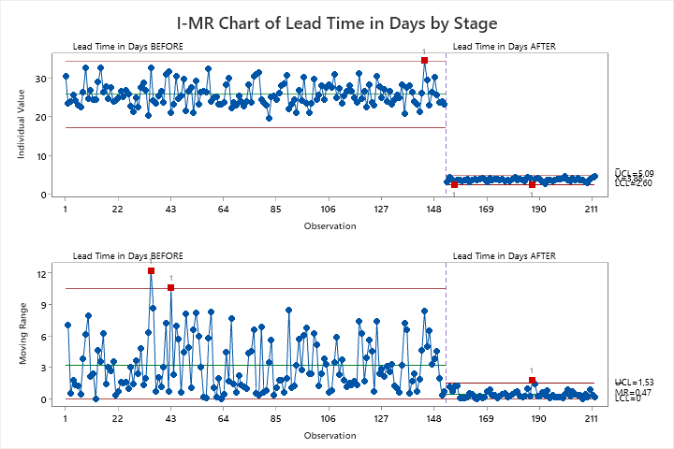
PROCESS IMPROVEMENT CONFIRMATION: STABIBILITY

Slide 62



PROCESS IMPROVEMENT CONFIRMATION: CAPABIBILITY
The process improvement has shown a significant reduction in lead time, as evident from both the boxplot and process capability charts. Lead time has dramatically decreased from an average of around 25 days to less than 5 days. This improvement reflects enhanced efficiency in our workflow, moving from a poorly performing state (Cpk = -2.417) to a capable process (Cpk = 0.925). The successful reduction of lead time confirms the effectiveness of implemented measures, positioning the process well within acceptable limits and boosting overall customer satisfaction and operational performance.

Slide 63
CONTROL PROJECT REVIEW CHECKLIST
Complete Defining the Problem | Complete
Customer Experience re-evaluated? | Yes / No
Control measures in place? | Yes / No
Control charts implemented? | Yes / No
Process Control Documented completed? | Yes / No
Results validated graphically and statistically? | Yes / No
Handover signed off? | Yes / No
Financial benefits tracked? | Yes / No
Celebrated success? | Yes / No

Slide 64
Forecasts Associated with States of Nature
State of Nature 1: No Change in Process
Lead time continues to rise above 26 days.
Cost per claim increases beyond $8.
Churn rate escalates past 12% annually.
State of Nature 2: Partial Implementation
Digitization only in mailroom and clerical steps.
Lead time reduces to ~15 days.
Accuracy improves marginally to 70%.
Cost per claim drops to ~$6.50.
State of Nature 3: Full Implementation of Selected Alternatives
TO-BE process fully digitized and optimized.
Lead time reduces to < 6 days (industry benchmark).
Accuracy improves to > 85%.
Cost per claim stabilizes at $5 or lower.

Slide 65
Conclusion
The Prosim case demonstrates the application of structured decision analysis and Lean Six Sigma methodologies to solve a complex engineering problem involving process inefficiencies. By defining the problem using data, analyzing root causes, evaluating alternatives with decision-making tools, and optimizing the solution for business and customer outcomes, the project meets both academic and real-world problem-solving criteria.
This assignment highlights the importance of integrating engineering principles, stakeholder needs, and data analysis in addressing ill-defined problems. Through the chosen solutions, Prosim Insurance is on track to recover its market position and deliver superior service.

Slide 66
Appendix

